Slide 1

P r e s e n t a t i o n o n P r o j e c t R e p o r t
PROPERTY RENTAL SYSTEM
Under the Guidance of
SACHIN SHAH
Presented by:- Tanu Singh

Slide 2
Table of Content
Objective
Introduction
Project Goal
Technology Stack
Snapshots(Result)
References
Conclusion

Slide 3
Objective
To create a user-friendly marketplace that facilitates seamless connections between property owners looking to rent out their accommodations and travelers seeking short-term lodging, fostering a vibrant community that prioritizes trust, convenience, and exceptional guest experiences.

Slide 4
Introduction
Welcome to my presentation on the development of an innovative marketplace designed to connect property owners with travelers seeking short-term accommodations. Our goal is to create a user-friendly platform that facilitates seamless interactions between those looking to rent out their properties and individuals searching for the perfect place to stay. By prioritizing trust, convenience, and exceptional guest experiences, we aim to foster a vibrant community that not only meets the needs of both hosts and guests but also enhances the overall travel experience. Today, we will explore our platform's features, market potential, and our vision for shaping the future of short-term rentals.

Slide 5
Project Goal
Develop a User-Friendly Marketplace: Create an intuitive platform that simplifies the process of connecting property owners with travelers seeking accommodations.
Enhance Trust and Security: Implement robust verification processes and transparent communication channels to foster trust between hosts and guests.
Prioritize Guest Experience: Focus on delivering exceptional customer service and support to ensure a positive experience for all users.
Foster a Vibrant Community: Build a strong community of hosts and travelers that encourages sharing local experiences and insights.
Implement Effective Marketing Strategies: Utilize targeted marketing to attract both property owners and travelers, ensuring a diverse range of listings.
Adapt to Market Trends: Continuously gather user feedback and analyze market data to adapt our platform to changing demands and preferences.

Slide 6
Technology Stack
HTML
CSS
JavaScript
Node.JS
Express.js
MongoDB

Slide 7
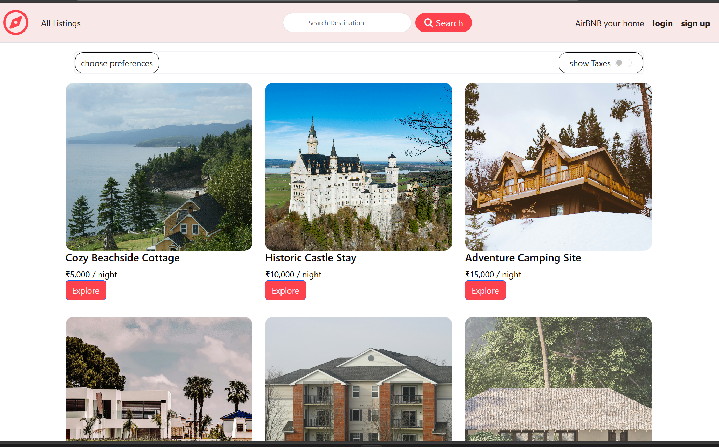
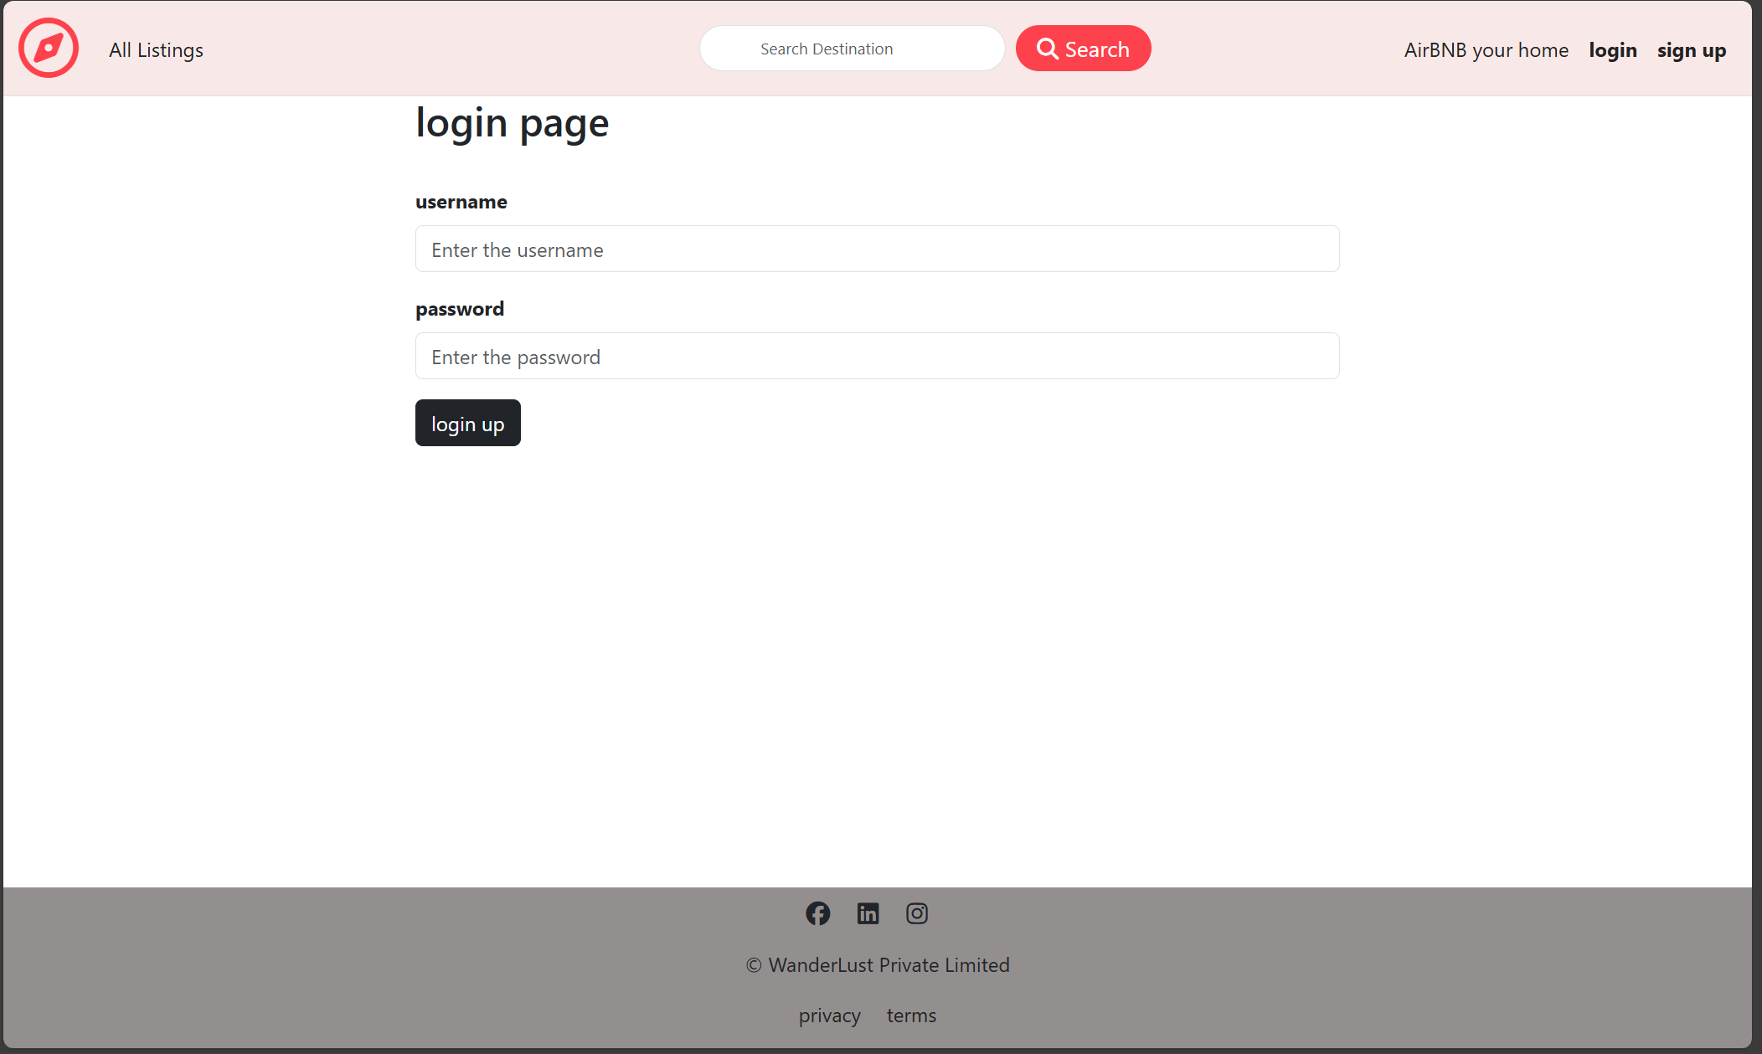
Snapshots
Home Page
Login Page

Slide 8
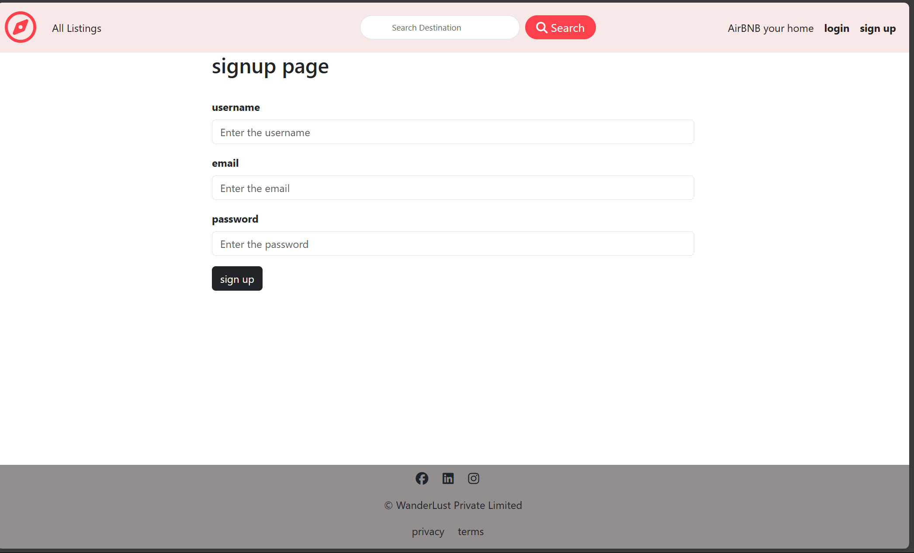
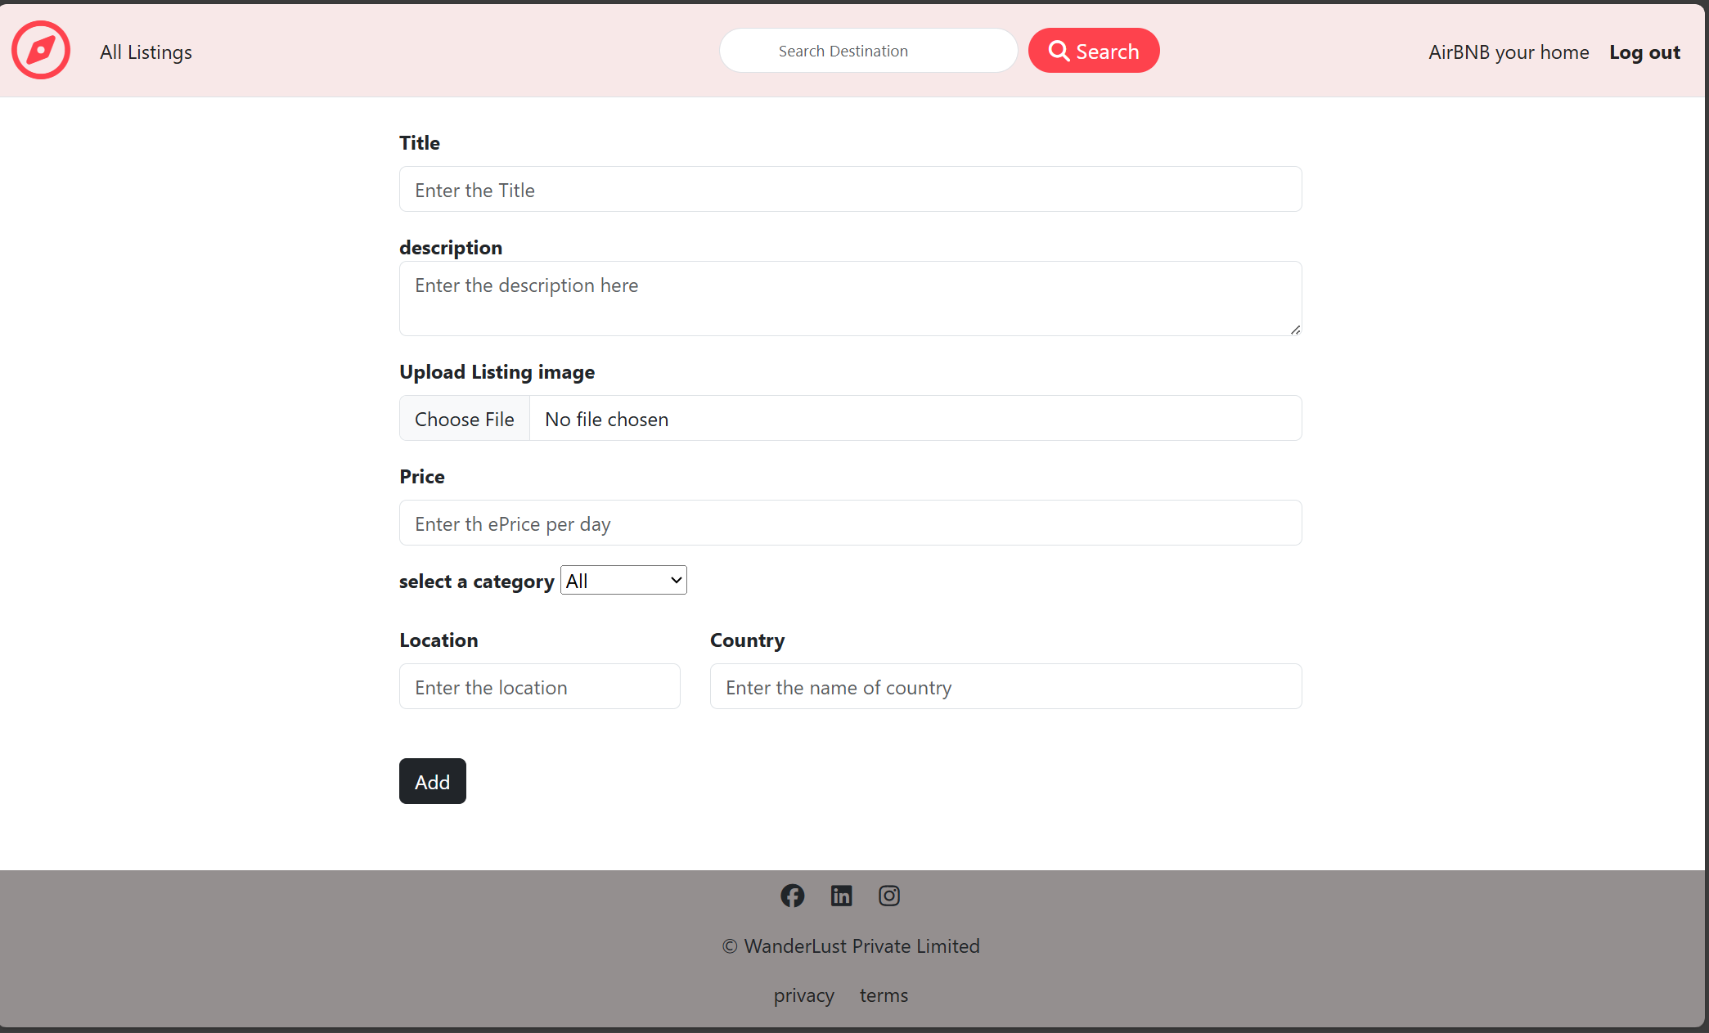
SignUp Page
Property Info

Slide 9
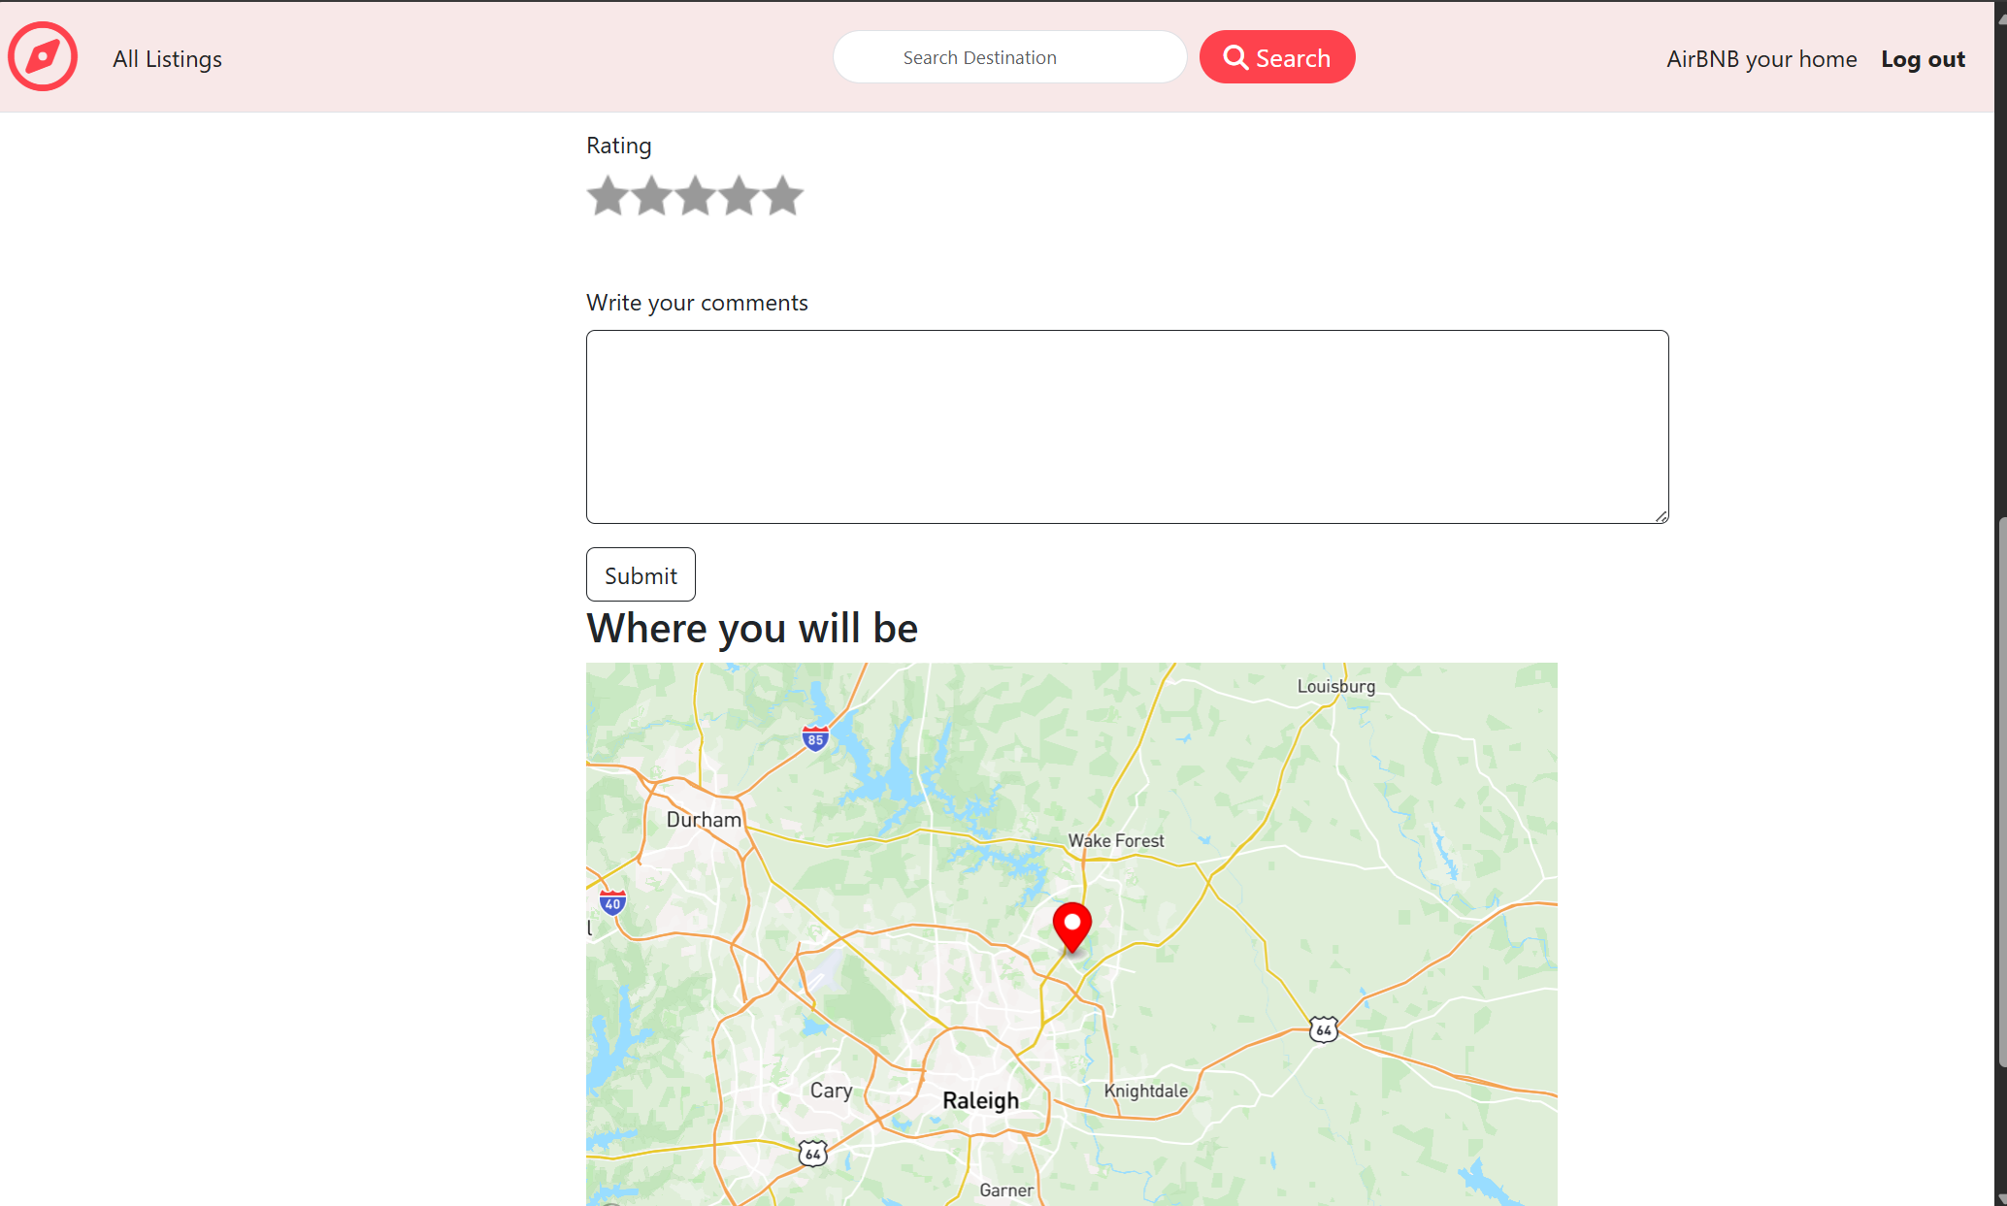
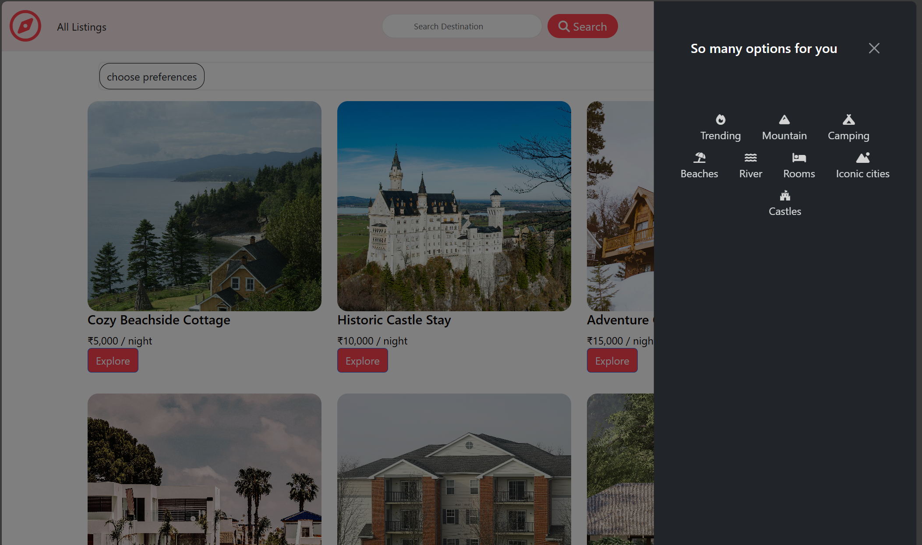
Destination Page
Get Preferences Page

Slide 10
References
Websites:
1-Airbnb official blog
2-Statista
Industry Reports:
1- Global Vacation Rental Market Report" by Market Research Future.

Slide 11
Thank you

